Slide 1

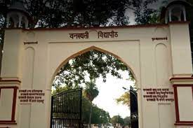
DEPARTMENT OF COMPUTER SCIENCE
“HOME CALLING”
GROUP MEMBERS
SHAMBHAWI KUMARI
KOMAL CHOUDHARY
RAKSHITA SHARMA
SAUMYA

Slide 2
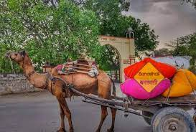
1. Introduction
1.1 Purpose
The document focuses on describing the software requirements of the project, and a website for generating homegoing journey plans for Banasthalites. This project would be carried out to meet the software development requirement of the home call. The document focuses on all the functional and non-functional performance and security requirements of the project
1.2 Scope
Our software product will be named home calling and it will be a website that will provide a home journey to bansathalites. it will give the information and booking links of the needed transport system like a bus. It will also provide meal connectivity between two people from the same destination.

Slide 3
2. Overall description
2.1 Product perspective
Home calling is to provide a safe and secure journey to the girls of Banasthali. With this, we will try to provide confusion and fraud-free journeys. Being a Banasthalite we all face some kind of issues at the time of going home many times we got scammed by the girls. who claimed that they are booking agents of buses and after getting the money they get vanished so our website will provide them with authorized information about transport systems like buses from Banasthali to their destination. It will also provide the option of meals and connectivity here connectivity means two or more girls from the same destination can connect.

Slide 4
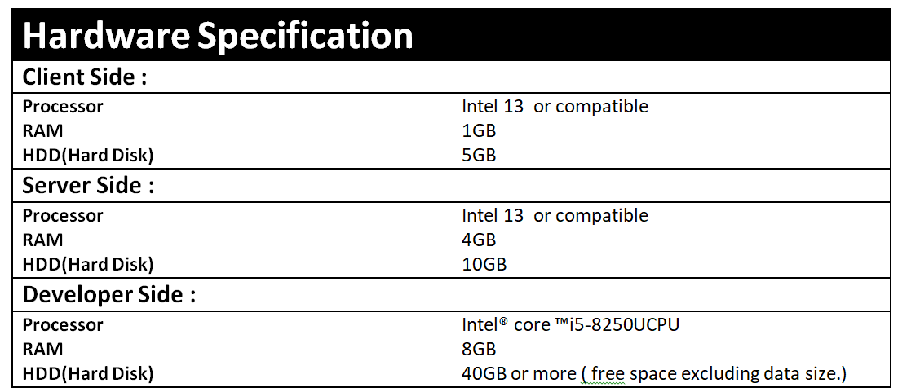
2.2General description
2.2.1 Hardware Interface

Slide 5
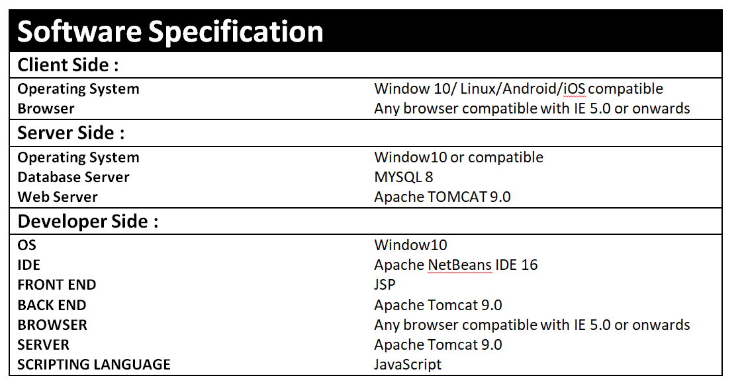
2.2.1 Hardware Interface
2.2.2 Software Interfaces

Slide 6

2.2.3 Communication Interface
1. Servers on the Internet will be using the HTTP/HTTPS protocol.
2. Clients on Intranet will be using TCP/IP protocol.
2.3User Characteristics
The user must be familiar with GUI components.
1. Admin: The head of the database. Only he
can make changes like deleting users, managing buses, availability of food, and also can manage connectivity of two or more travel mates. He should be well-versed in using the system and should be known about the
Database.
2. Student: In both the case of the individual and the
group participant, we assume the students are computer literate, well
aware of English, have a valid ID, and also type in the right kind
of data
3. Restaurant: We assume that the restaurant admin must be English literate and have good knowledge of technology with 24/7 net connectivity.

Slide 7
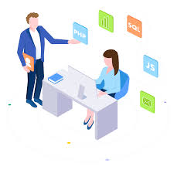
2.4 Assumptions and Dependencies:
1)Students can log in with their respective Smart Card ID and
password.
2) Internet facilities should available all the time.
3) Delivery charge will be free for food.
4) Transaction would be applicable through credit/debit card or UPI.
2.5 Technologies to be used
Front End: HTML,CSS , Javascript
IDE:Netbeans
Technology : JSP/Servlet
3.1 Functional Requirements
The application shall have the following functional requirements:
➢ Booking Module
➢ Create a destination
➢ Save destination
➢ Update destination info
➢ List destination
➢ Connect two people
➢Food booking

Slide 8
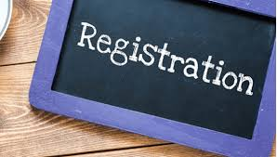
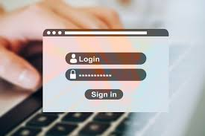
3.1.2 Register a profile
➢ Users have the option to register a profile with Home Calling from the menu bar.
➢ Select “Register” from the landing page, and follow the prompts to fill out and complete the registration.
a. Information will be stored on the database so the website can allow customers to
plan/save/edit/delete trips in the future.
.
3.1.3 Login to profile (edit, plan, view saved trips)
1. From the homepage, users, once registered, can log in to their profile to
a) plan a destination
b) edit their profile details
c) view, edit, or cancel any saved destination.

Slide 9
3.1.4. Planning a trip
1. Students will be able to save the destination.
2. Students fill in the required information, such as their source and destination, meal preferences, time preferences, and the number of people they are traveling with.
3. Students can modify (change/delete/add) the suggested trip option.
3.1.4. Logout to Profile
a. Logout from the profile.
Use cases
Use case 1- ADMIN
USE CASE TABLE FOR ADMIN

Slide 10
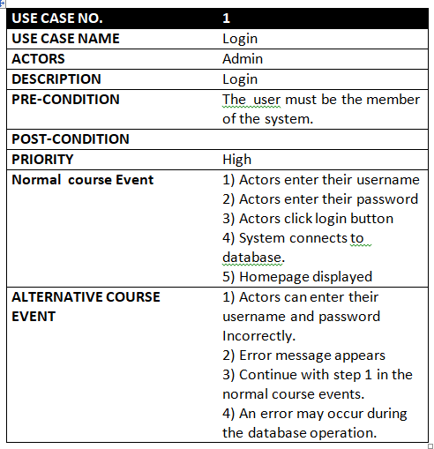

Slide 11
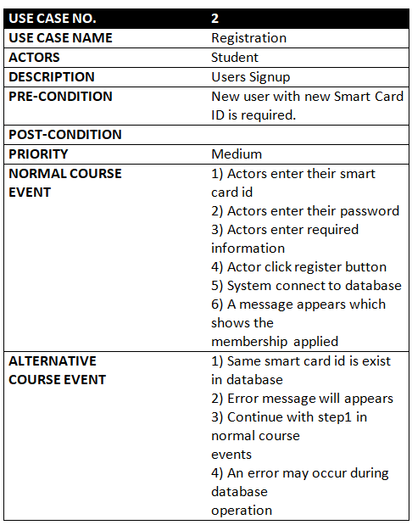
USE CASE TABLE FOR STUDENT

Slide 12
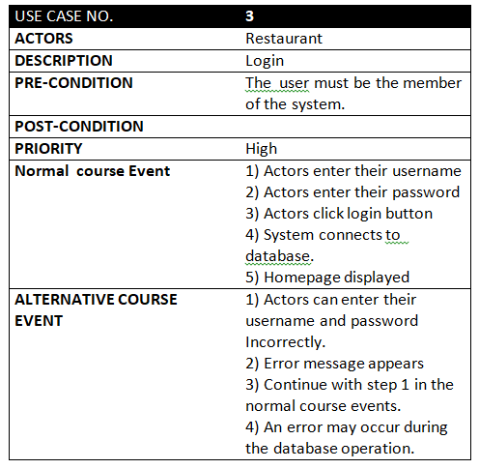
USE CASE TABLE FOR RESTAURANT
Use case diagram

Slide 13
LOGIN
ADD/UPDATE/DELETE TECHNIQUE
RESET PASSWORD
VIEW USERS
ADMIN
VIEW FEEDBACK
Use case diagram for Admin
LOGOUT

Slide 14
REGISTER
LOGIN
UPLOAD DATASET
MANUALLY CHOOSE
RECOMMENDED
UPDATE AND RETRIEVE PASSWORD
User
VIEW PREVIOUS DATASET
Use case diagram for User
GIVE FEEDBACK
LOGOUT

Slide 15
LOGIN
ADD/UPDATE/DELETE FOOD
DELIVER ORDERED MEAL
VIEW FEEDBACK
RESTAURANT
LOGOUT
Use case diagram for restaurant

Slide 16
3.2 Non functional Requirements(Software System Attributes)
Software System Attributes
There are a number of quality attributes of software that can serve as requirements. It is important that required attributes be specified so that their achievement can be objectively verified.
RELIABILITY
All the information provided by the website Home Calling is reliable.
AVAILABILITY
The availability of the website Home Calling depends upon the internet connection of the client. Since this is a client server-based website, the website will be available all the time. Students should have an account to access all the features of the website and in case, she is unregistered they should sign up to the system. Moreover, before signing up the guest students can browse through the website.

Slide 17
SECURITY
The authorization mechanism of the system will block unwanted attempts to the server and also let the system decide which privileges the students possess. The system has different types of students (Admin and Students), so there are different levels of authorization. The system has different modules which have been assigned certain functions, thus providing data abstraction and encapsulation.
MAINTAINABILITY
The requirements and modules that are explained in this document are enough to satisfy the student’s needs and requirements. The maintainability shall be easily done by integrating new modules and updating the existing modules at specific intervals of time.
FLEXIBILITY Website can be used by different actors in their own manner. For the developers and designing team, the operational program can be modified and debugged so as to provide enhancements to the website.

Slide 18
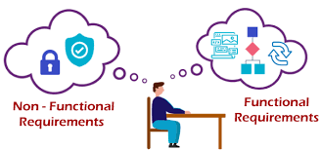
PORTABILITY
The Home Calling website is an online service created in a HTML framework and thus can easily be accessed by all.

Slide 19

SDS
SOFTWARE DESIGN SPECIFICATION
“HOME CALLING”

Slide 20
1. Introduction
System Design Specification tells us how our software is
going to build. It includes various diagrams to show the
entire database and the relationship among all database tables.
The project “HOME CALLING” tries to give the experience of a confusion-free, fraud-free journey to home during holidays and casual leave. As the name suggests this project provides information on all routes, available seats in buses, food from your favorite canteen at your seat, and connecting two people of the same destination. Our project is a one-stop solution for all journey-related problems. The software allows the sculpting of the database based on the requirement of the Banasthalite(who is willing to go home) and then provides all things according to their convenience and availability.

Slide 21
1.1 Purpose
1. To develop software for managing the journeys of Banasthalites.It is a powerful and user-friendly online service tool.
2. The software will computerize the existing journey style. The existing journey style has lots of confusion and fraud
1.2 Scope
Our software product will be named home call. and it will be a website that will provide a home journey to Bansathalites it will give the information and booking links for the needed transport system. It will provide meals.

Slide 22
2.2- Component Interface Description
Admin
I/P- Login and password
O/P- Logged in, admin can handle all the D/B updating. He can add new buses/restaurant, announce the important dates, declare vacant seats, and view the feedback of the students regarding
Buses/food.
Registration
I/P- Student name, smart card ID, password, course, email id, contact no.
O/P- Student gets registered.
Vacant Seat
I/P- Click on the particular Bus for which you want to get
information.
O/P- Information displayed.

Slide 23
Booking
I/P- Click on a particular results item (book seat)
O/P:-The desired can book and see the detailed information
Regarding the bus.
Connect to people
I/P- Click the destination and connected with your travel mates.
O/P- Connected to the TravelMate.
Dates and Announcements
I/P- Click on a particular date.
O/P- Information regarding the scheduling of the different
Vehicles, food, people, and the like are displayed.

Slide 24
Food
I/P - Click on your order.
O/P - Information regarding the menu displayed.
3. High-Level Design
High-level design (HLD) explains the architecture that would be used for developing a software product. The architecture diagram provides an overview of an entire system, identifying the main components that would be developed for the product and their interfaces. The HLD uses possibly nontechnical to mildly technical terms that should be understandable to the administrators of the system.

Slide 25
ER Diagram
An entity–relationship model (or ER model) describes interrelated things of interest in a specific domain of knowledge. A basic ER model is composed of entity types (which classify the things of interest) and specifies relationships that can exist between entities (instances of those entity types).

Slide 26
Security
answer
Payment id
Security
question
Payment
Table
User Id
Admin
Ticket no.
Password
Done
Smart id
Ticket id
Order id
First name
Password
Payment id
Bus no.
Cast name
Security
Answer
Student
Book ticket
Tickets
Smart Id
Mobile no.
Security
Question
Total cost
Date
Room no.
E-mail
Ticket fare
Time
Hostel name
No. of passenger

Slide 27
Search
Order food
Connects
Vacant Seat
Bus no.
Food id
Ticket id
Source
Time period
Smart Id
Order id
Destination
Bus
Food orders
Price
Bill Amount
Ticket id
No. of Seats
Journey Vehicles
Select food
Group
Food id
Hostel Name
Report
Journey
Date
Snacks &
Dinner
Destination
Smart id
Time
Food
Source
Ticket id
Feedback
Restaurant name
Smart id
Lunch
Price
Smart id
Description
Dinner
Breakfast

Slide 28
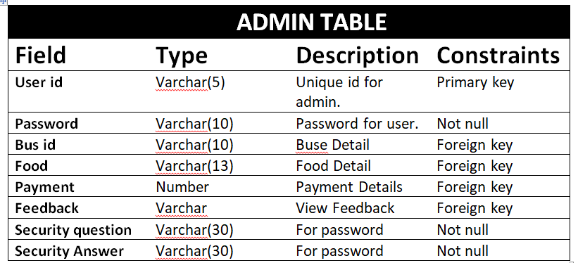
Data Design
Description:
i. In this we include, maintain & format the whole Database and its tables.
ii. The tables corresponding to each of entity, holding the information about them are designed.
iii. The tables have the fields, their description, and their data type as well as integrity constraint.

Slide 29
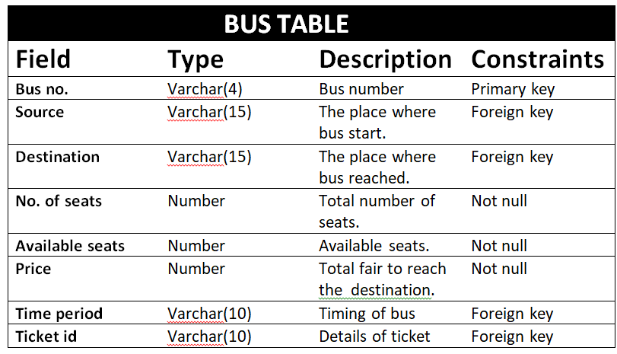

Slide 30
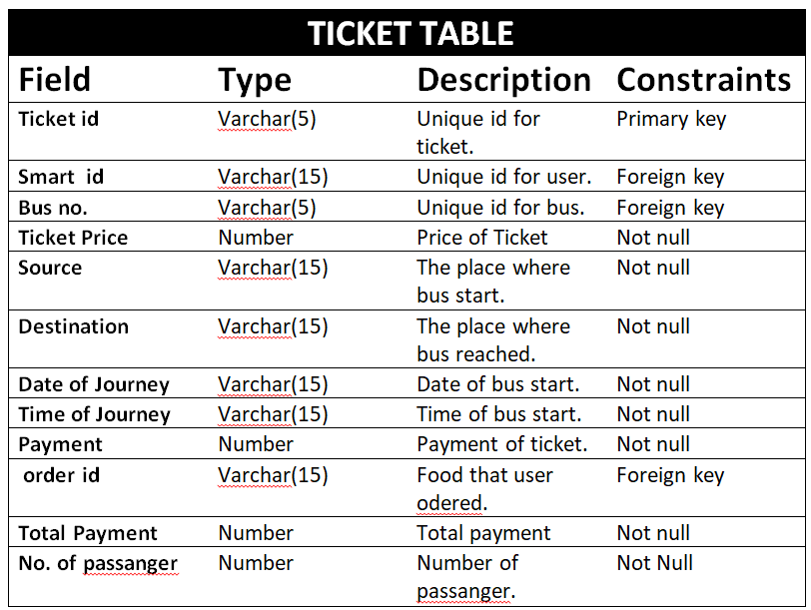

Slide 31
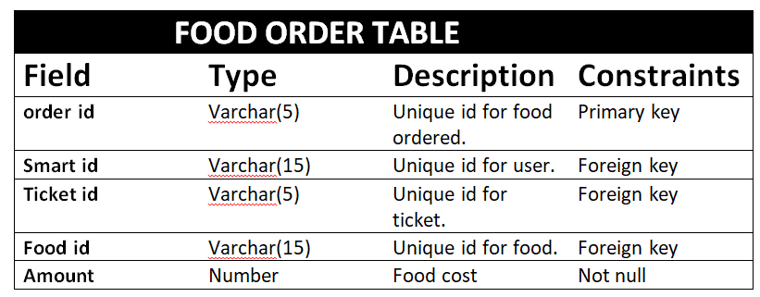
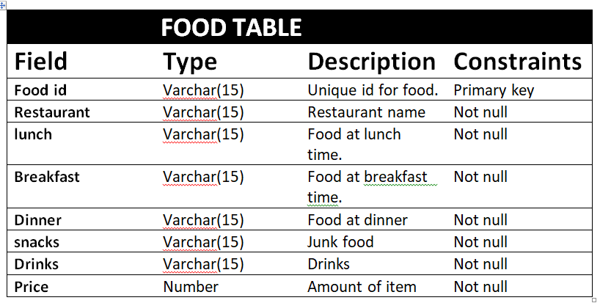

Slide 32
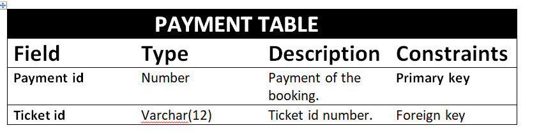
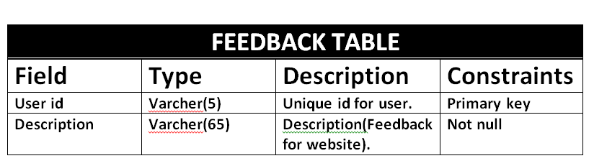

Slide 33
Data Flow Diagram
A data-flow diagram is a way of representing the flow of data of a process or a system (usually an information system). The DFD also provides information about the outputs and inputs of each entity and the process itself. A data-flow diagram has no control flow, there are no decision rules and no loops.

Slide 34
Login
STUDENT
ADMIN
Bus detail
Register\login
Food detail
Order info
Booking info
Feedback info
If invalid detail than cancel
HOME
CALLING
Booking ticket
Response
Receipt
Cancel if details not valid
Connect to people
Response
Feedback
Card info
BANK
Food detail
RESTAURANT
Order info
0-LEVEL DFD

Slide 35
Student
Response
Bus Detail
Admin
Request
Bus info
Status
Bus
Food Detail
Request
Cancel
Store
Booking
Record
Food info
Response
2.0
View
Buses
Admin
Status
Ticket Info
Login
11.0
Authentication
Response
Registration
3.0
Book
Ticket
Food
Admin
Cancel
Status
Restaurant
Response
Login
Student
Cancel
Request
4.0
View
Food
Status
Restaurant
Request
Feedback
Message
Request
Response
Status
8.0
Feedback
Store
Food info
7.0
Generate
receipt
Request
5.0
Book Food
Restaurant
6.0
Payment
Booking Record
Feedback
Message
Response
Card-Info
Store
9.0
Connect to people
Payment
Connect Info
Request
Response
Bank
Payment
Confirmation
Bank
Response
1-LEVEL DFD

Slide 36
Start
ADMIN FLOW CHART
Login
Admin
id
Password
No
Check
Id &
Password
Yes
Login Successfully
Manage

Slide 37
Bus
Restaurants
User
Add bus
Update bus
Delete bus
Add
Restaurants
Update
Restaurants
Delete
Restaurants
Add User
Remove User
Yes
Yes
Yes
Yes
Yes
Yes
Yes
Yes
Save Data
Log Out
End

Slide 38
START
USER FLOW-CHART
No
REGISTER
Have an account
Yes
LOGIN
Smart id
password
No
Check smart id password
Login successfully
Enter source
Enter destination

Slide 39
Enter date
No
Check buses
Yes
No
Check seat
Yes
Order food
Total payment
Yes
No
Payment confirmed
logout
End

Slide 40
START
RESTAURANT FLOW-CHART
LOGIN
Smart id
password
No
Check smart id and password
Yes
Login successfully
Decline order
User place order
Accept order
No
Payment
Yes

Slide 41
LOGIN
LOGIN
LOGIN
LOGIN
START

Slide 42
TESTING
Software testing can be stated as the process of validating ad verifying that a software program/ application/ product:
1. Meets the requirements that guided its design and development;
2. Works as expected; and
3. Can be implemented with the same characteristics.
Testing is the process of making sure that the program performs the intended tasks.
1. Unit Testing:. Each component or part of the system is tested individually.
2. Module Testing: A collection of dependent components such as an object class, procedures, and functions are tested in this testing.
3. Integration Testing: In this, many units tested modules are combined into sub-systems, which are then tested.
4. System Testing: Entire system software is tested. It is a testing of the system against its initial objectives.

Slide 43
THANK YOU

